Slide 1
Building Clinical Relationships that Last
By: Heather Osness

Slide 2
Objectives
The learner will recognize why a good relationship is vital to a programs success
The learner will identify ways their program can show appreciation to their clinical sites
The learner will discover good communication practices and how to be in sync with their clinical sites

Slide 3
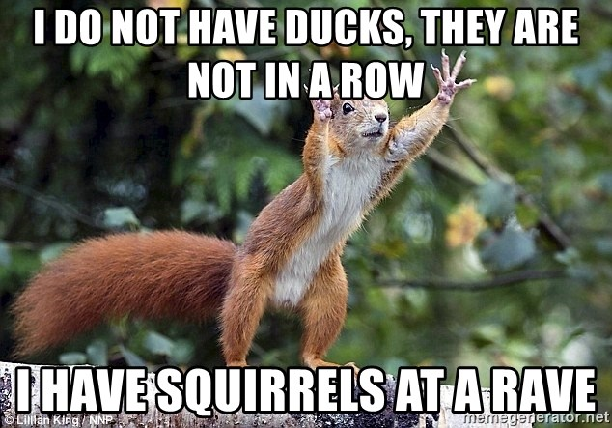
Disclaimer…

Slide 4
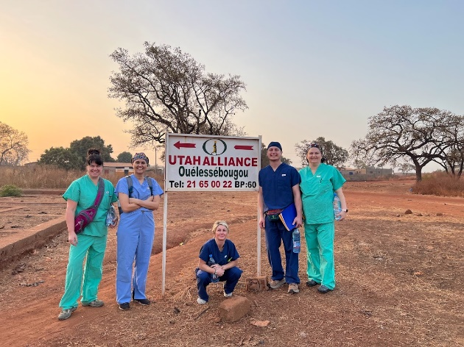
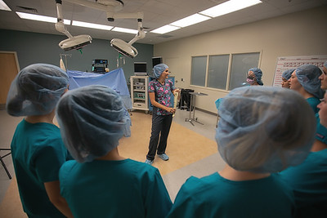

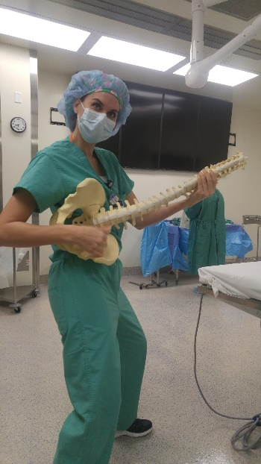
About Me
Mother of 5
Practicing CST since 2015
Teaching since 2019
PD since January 2020
Recently returned from a humanitarian trip in Mali West Africa

Slide 5

Good relationships are vital to our program success
Symbiosis is EVERYWHERE
Columbian Lesserback Tarantula and the Dotted Humming Frog

Slide 6
Mutualistic Symbiosis
Long term mutually beneficial relationships between two organisms
Much like these relationships in nature we want to provide the same mutually beneficial relationship to our clinical sites

Slide 7
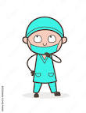
But why….
Program Benefits
  Clinical experience is necessary for completion of the program
  Good rapport can give you an edge over competing programs
  Willing to “share” valuable techs for teaching
Clinical Benefits
  Year long job interview
  “Courting” desirable students
  Students are more likely to apply at familiar clinical sites

Slide 8

Other things to consider…
We rely on good clinical sites to help in meeting our accreditation standards
We use their leadership for our Accreditation Committees
Having open communication allows you to get things done faster

Slide 9

How do we get there?
There are lots of great paths we can take to build this relationship.
Today we are going to focus on two paths
Appreciation and Communication

Slide 10

The science behind appreciation
Think back to your most memorable experience in clinicals as a student
Gratitude can smooth over those “yucky” experiences
We can show gratitude to facilities as a whole as well as individual preceptors

Slide 11
Provide education
Preceptor Education experiences
  Going through AST you can provide education AND CE credit
This helps get them the CE’s they need to stay certified
Also helps preceptors build skills related to teaching
Helps relieve some of the preceptor’s anxiety and stress of teaching a student

Slide 12
Some things you can teach
How to give good real feedback
  Why that matters to the success of a student
How to set goals with a student
How to let the student lead but we watchful in the background
Be sympathetic
Teaching is also a learning experience for the preceptor

Slide 13
Facility Education
Be the source they need for procedure and policies
  Hint- Use the AST.org website for direction
Provide them with information about State Assembly workshops and Conferences
  If you aren’t already involved in your State Assembly do it!

Slide 14
Your time to share

Slide 15

Communication: Getting on the same page

Slide 16

Common miscommunications
Scheduling
Preceptor expectations
Level of student ability
Proper feedback from preceptors
Who can be a preceptor
What the preceptors are teaching the students

Slide 17
Program Advisory Committee
This is a great tool to help you communicate effectively with your clinical sites
They get insight into how you run your program but they also have the ability to voice their opinions, concern or praise

Slide 18
Employer Satisfaction Surveys
Make a personal phone call before sending the survey to let them know its coming
Get in touch after you get the survey back if there are any concerns expressed in the survey

Slide 19
Additional communication ideas
Have regular meetings with management
Address concerns within 24 hours of receiving feedback
  Its tempting to put it off or hope it goes away but don’t do it!
Don’t rely solely on others to build these relationships

Slide 20
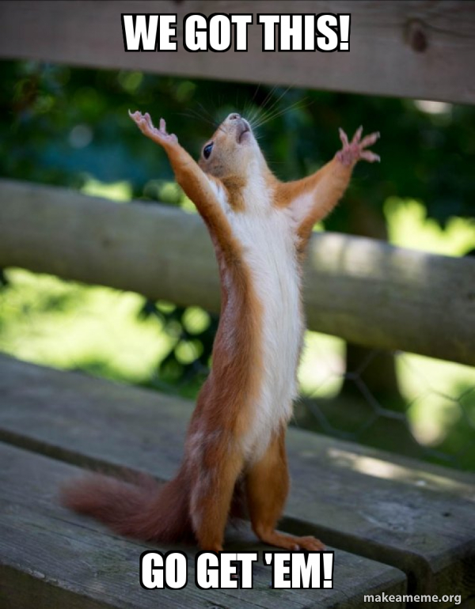
Comments or Questions

